Slide 1
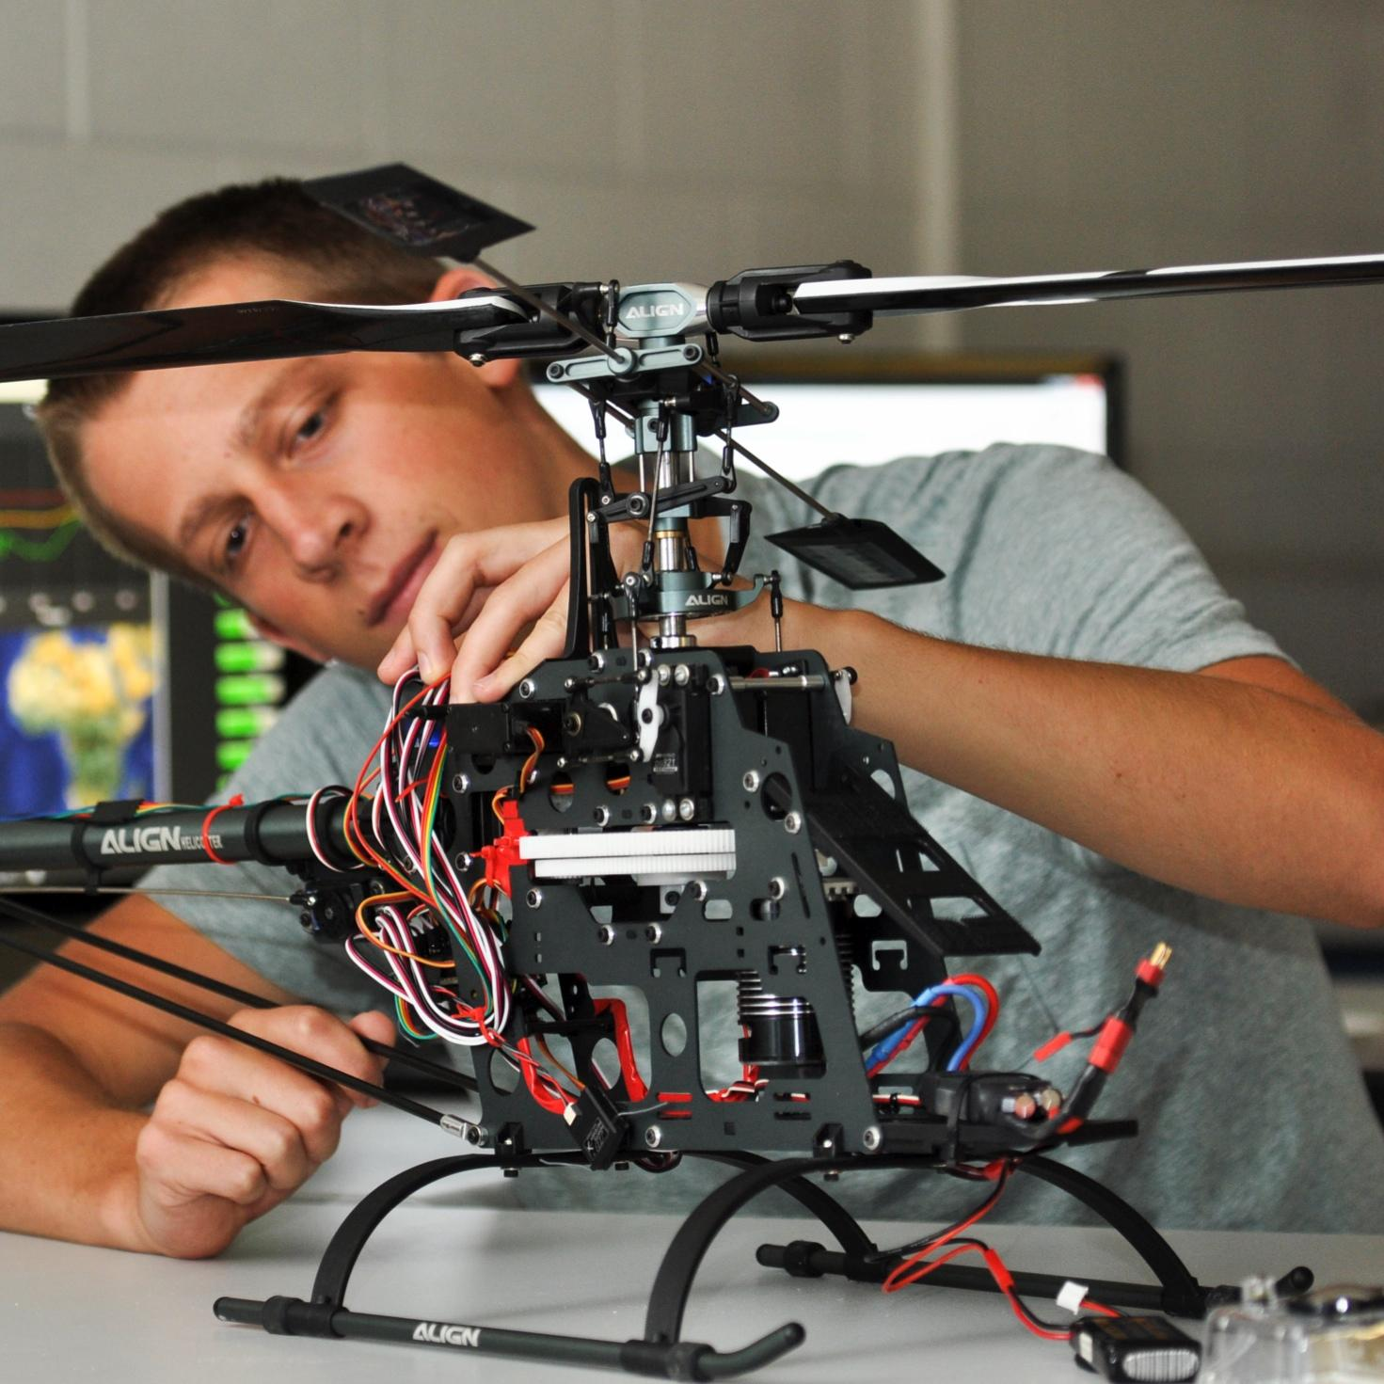

Team 14: Perfect Pour Over Coffee
Bi-Weekly Update 4
Mark Golla, Cindy Ho, Zeeshan Virani
Sponsor: Stavros Kalafatis
TA: Eric Robles
Notes:
Intro should take 30 seconds

Slide 2
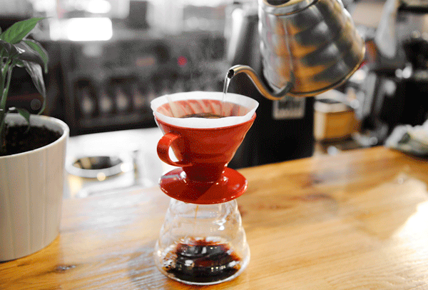
Problem Statement:
Issues pertain to human errors & inconsistencies with pouring methods
Current method is very tedious and imprecise
Our Coffee System will:
Focus on automating the process by utilizing machine learning & built-in sensors to regulate temperature & water saturation levels
Create the perfect cup of coffee for each user by tailoring user preferences of roast type through an android app & machine learning

Slide 3
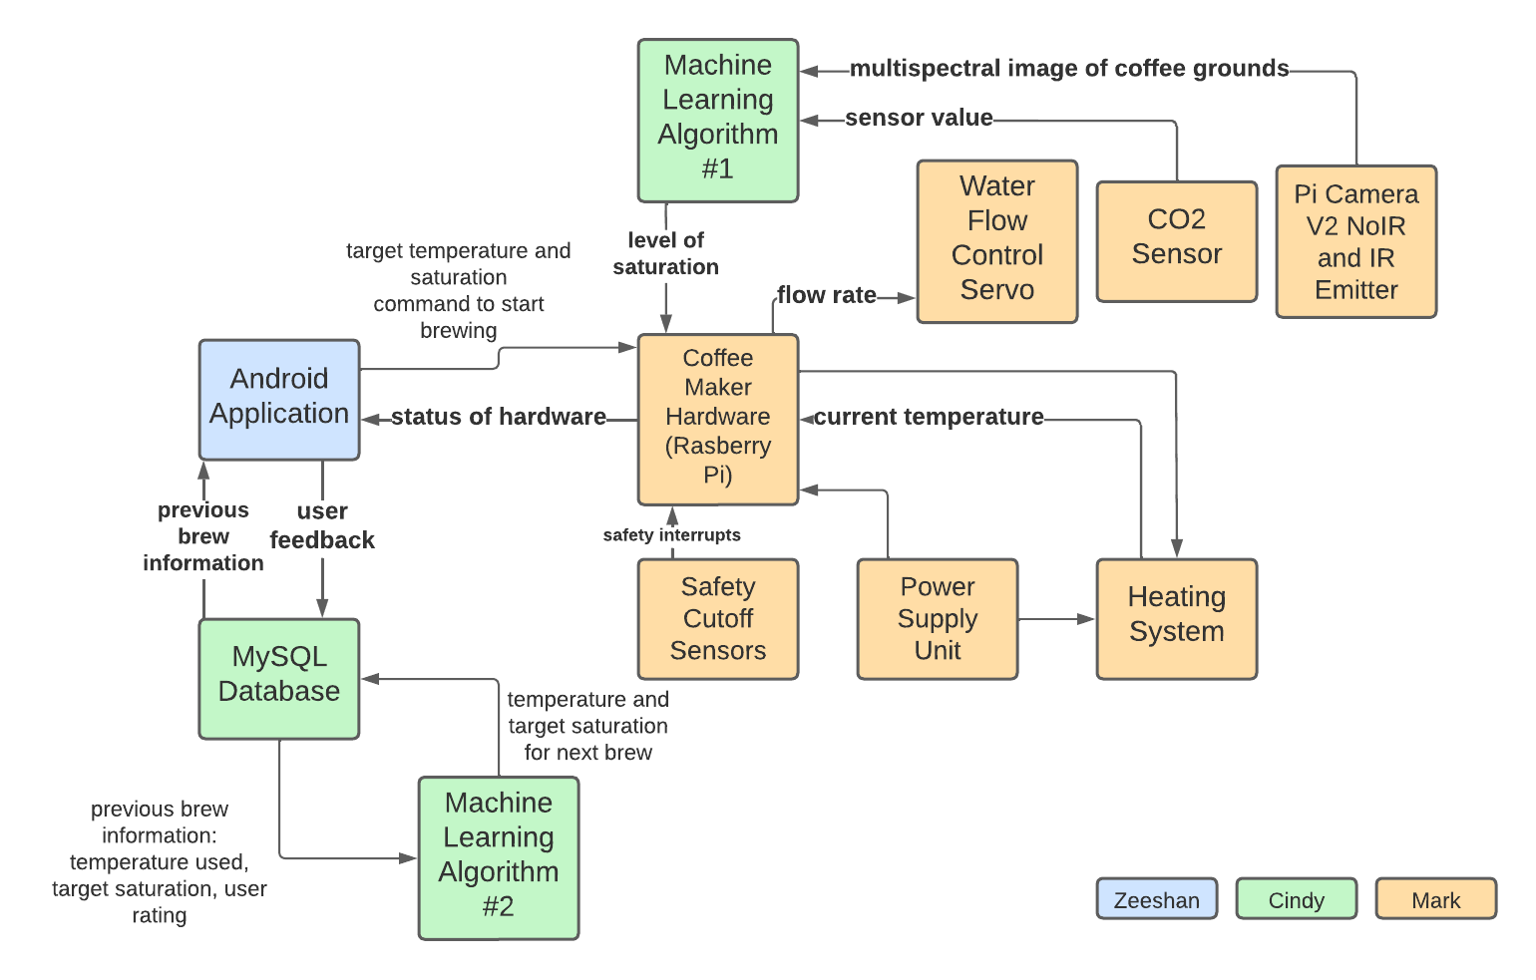
System Overview

Slide 4
Hardware / Peripherals Subsystem
Mark Golla
Accomplishments since the last presentation 18 hours | Ongoing progress/problems and plans until the next presentation
Soldered sensor interconnect PCB and tested functionality Assembled/ tested mini ring light Applied a conformal coating to boards to protect against moisture Prototyped housing with cardboard | Continue work on housing in solidworks and 3d printing Import the app communication code

Slide 5
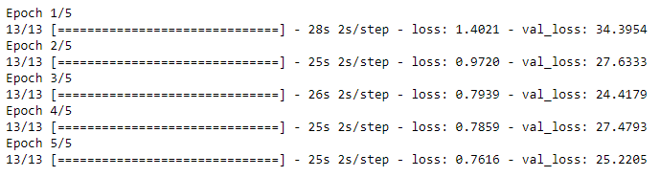
Machine Learning & Database Overview
Cindy Ho
Accomplishments since the last presentation 15 hours | Ongoing progress/problems and plans until the next presentation
Both models Integrating scripts to Firebase Database Cloud by converting script to Tensorflow Lite User Feedback Prediction Accuracy of 71% Water Saturation Prediction Loss of .76 | Continue validating both models Finish integrating scripts to Firebase Cloud

Slide 6
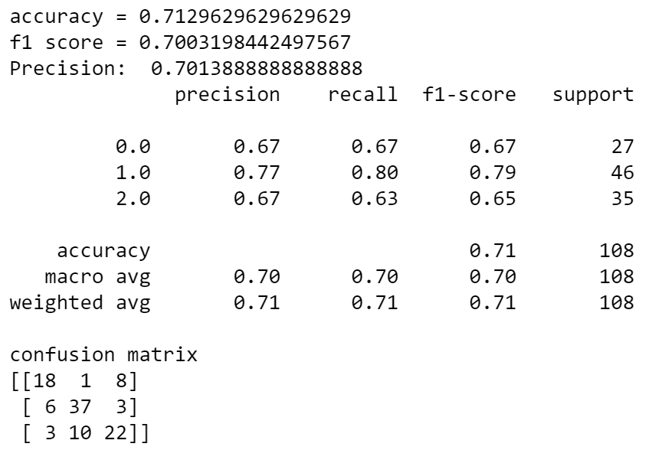
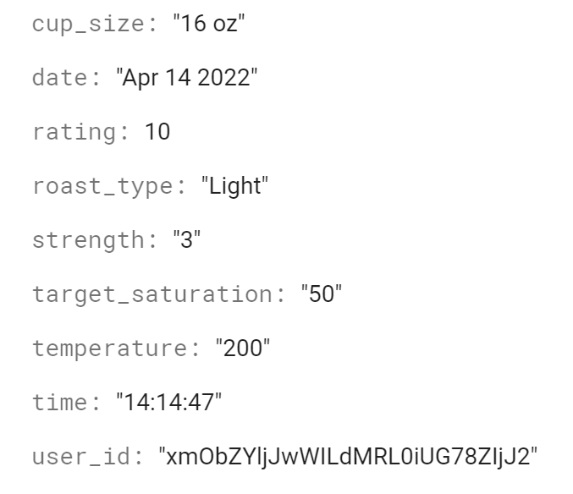
Machine Learning & Database Overview
Cindy Ho

Slide 7
Android Application
Zeeshan Virani
Accomplishments since the last presentation 15 hours | Ongoing progress/problems and plans until the next presentation
Bluetooth code on hardware has been rewritten to support connection loss and allows Mark’s system to send messages to the smartphone. | Continue writing bluetooth code to account for any other errors and run testing. Run various tests on app with all integrations done.

Slide 8
Parts Ordering Status
Part | Status
Raspberry Pi, Picam V.2, Smartphone | Received
Coffee for testing, LEDs, CO2 Sensor, Proximity Sensors | Received
Carafe/Filter | Received
Water Distribution System Components (Sheet metal, fasteners, compression spring, stepper, stepper driver) | Received
Water Heating System Components (Heating Element, SSR, high current cable) | Received
Parts for Mechanical Design (ABS printer filament, sheet metal, mineral wool insulation, stainless steel reservoir, silicone sealant) | Received
Ring Light Mini PCB, Solenoid Valve | Received
Pi HAT PCB, PCB components, New LEDs | Received
Notes:
Michelle

Slide 9
Execution Status
Date | Cindy | Mark | Zeeshan | Status
09/08/22 | - Increase accuracy of user preferences algorithm & look into reinforcement learning | - Finish fixing leak through valve installation - Camera mounting for new training data - Adding threading to control system | - Testing of bluetooth connectivity | Completed
09/15/22 | - Assist with new training data collection - Continue collecting new training data | - Assist with new training data collection - Continue collecting new training data | - Implement background capabilities for bluetooth system | Completed
09/22/22 | - Integrate ML onto HW | - Working on housing - Hosting app interface on actual hardware | - Implement background capabilities for bluetooth system | Completed
09/29/22 | - Integrate ML onto HW - Integrate Database with HW | - Working on housing - Hosting app interface on actual hardware | - Data handling between Pi and Android device | Completed
10/06/22 | - Integrate Database with HW | - Validate app integration - Working on housing | - Data handling between Pi and Android device | In Progress

Slide 10
Execution Status Continued
Date | Cindy | Mark | Zeeshan | Status
10/13/22 | - Validate integration between ML & HW - Validate integration between Database & HW | - Data handling between Pi and Android device | - Data handling between Pi and Android device | In Progress
10/20/22 | - Validate integration between ML & HW - Validate integration between Database & HW | - Working on housing | - Implement notification system - Data handling between Pi and Android device | Not Started
10/27/22 | - Validate integration between ML & HW - Validate integration between Database & HW | - Continue validation - Working on housing | - Add data to support page | Not Started
11/3/22 | - Continue validation | - Continue validation | - Testing of integrated system | Not Started
11/10/22 | - Continue validation | - Continue validation | - Testing of integrated system | Not Started

Slide 11
Validation Status
Test Name | Success Criteria | Methodology | Status | Responsible Engineer(s)
Functional User Interface | User is able to navigate throughout all pages within the application without bugs, crashes, or need for outside intervention. | Open the application and handle it as an end user. | Passed | Zeeshan Virani
Android Application Storage | The Android application of the system shall not exceed 15 megabytes of storage. | Monitor frontend design images and functions size. | Passed | Zeeshan Virani
Application Connection With Raspberry Pi | The Raspberry Pi turns on an LED when a connection is established between the android application and itself. | Visually Verify connection has been established. | Passed | Zeeshan Virani
Database Connection With Application | The application is able to send and receive data from the database. | Send data to the database and then query to see if that data has been stored. | Passed | Zeeshan Virani
Brew Temperature Prediction | The machine learning algorithm is able to receive feedback from the user and can adjust the temperature up or down if the feedback is negative. | Data will have linear relationship between user feedback ratings and temperature to each user. If user has positive feedback, the temperature will stay constant. If user has negative feedback on too hot or too cold, the temperature will adjust in the direction that generates a positive outcome for the user. | Passed | Cindy Ho
Database Storage Amount | The database shall not exceed 65,535 bytes or 8.61 GB (Raspberry Pi maximum storage). | Return error output if user tries to exceed allocated storage space. | Passed | Cindy Ho

Slide 12
Database Storage Savings | The database is able to save user feedback ratings, temperature, and water saturation requirements. | Running the training data and checking if the database saves all of the data with no null responses. | Passed | Cindy Ho
Water Saturation Prediction Accuracy | The machine learning determines percentage of ground bean saturation within +/- 10% range. | Run initial training data and two subsequent train data tests through (train/test splits). Have a confusion matrix to compare results. | Passed | Cindy Ho
Input Voltage (Peripherals) | The input voltage level for the converter used for the Raspberrry Pi, Sensor Array, and Water Distribution Valve will convert 120VAC to 5 VDC at at least 5 Amps. | Use multimeter and a test load to validate input and output voltage levels. | Passed | Mark Golla
Mass | Mass of all hardware shall not exceed 15 lbs. | Measure entire system utilizing a scale. | Untested | Mark Golla
Volume | The size of the full system shall not exceed 48x48x48 inches. | Measure dimensions of system | Untested | Mark Golla
Basic Sensor Readings | Test the temperature sensor against a known working thermometer at ambient temperature and ensure CO2 value increases when breath or co2 from a duster is introduced | Test the CO2 and temperature sensors by connecting to the pi and writing scripts to receive their values | Passed | Mark Golla

Slide 13
Multispectral Camera | Successful capture of an image at each NIR wavelength and its compilation into a multidimensional image within less than one second. | The camera should be able to cycle through wavelengths and capture a full image of a white background as well as coffee grounds every second for 2 minutes. The images should be consistent and the light intensity should not saturate the camera | Passed | Mark Golla
Water Heating System | The temperature of water in the reservoir should be able to be held at a constant temperature anywhere in the range of 185 degrees F to 205 degrees F for 30 seconds without fluctuating more than 2 degrees | The temperature values will be swept in increments of one from 185 to 205 F in 5 F intervals and held at each step for 30 seconds | Passed | Mark Golla
Carafe Detection | The output should be below 1.8 V when the carafe is within 5mm and above 1.8 V if the carafe is further than 20 mm | The proximity sensor should output logic low when the carafe is against it and high otherwise. The output voltage will be measured in 5 mm intervals from the sensor from 0mm to 35mm | Passed | Mark Golla
Brew Quantity | The amount of water dispensed should be within 10% of what was requested. | Run the hardware with pre defined quantities and measure the amount of water dispensed to verify the dispensing mechanism | Testing | Mark Golla
Full System Demo | A user of the system can select brew type and cup size according to their needs and make a cup of coffee. | The system is able to complete when the camera reads the grounds to have reached the required saturation levels, the temperature sensor reads all of the temperature for water maintained, and CO2 levels are matched according to specifications. | Untested | Everyone

Slide 14
Thank You

